Slide 1
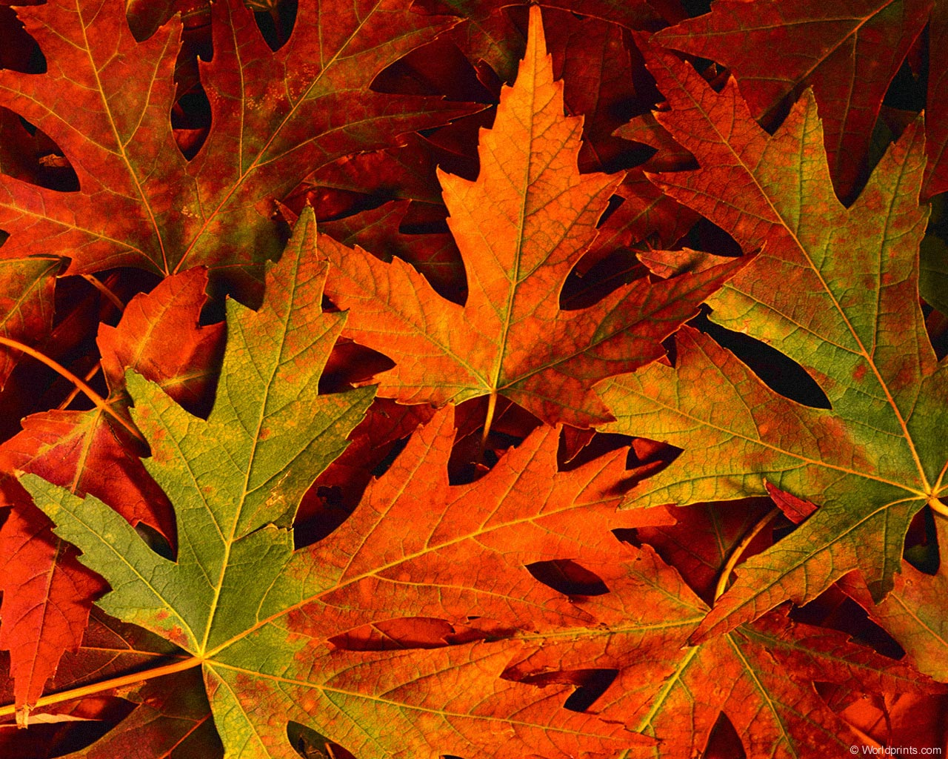
Welcome

Slide 2
Worship Song “We Believe” Video

Slide 3
Worship Song “We Believe” Video

Slide 4
Call to Worship
Leader: Despite how things may seem—God is good all the time People: All the time—God is good Leader: The Lord be with you People: Also with you

Slide 5
Unison Prayer
Almighty God, we gather to meet with
You for you are worthy of our praise. Cast out any distraction within us and around us that would keep us from truly worshiping You. Holy Spirit make us One. In Jesus’ name—Amen!

Slide 6
Hymn “When Morning Gilds the Skies” #215

Slide 7
Unison Prayer of Confession
Lord God,
In times of comfort and challenge, we have turned to idols instead of turning to You. We have chosen ways that provide us with pleasure instead of following Your purpose for our lives. We have been too concerned with our desires and our wellbeing to be concerned with the pain of Your people that are all around us. Forgive us for our selfishness. Forgive us

Slide 8
Unison Prayer of Confession
for our pride. Forgive us for our anger. Forgive us for our lust. Forgive us for willingly doing what is wrong instead of clinging to what is right in Your eyes.
Time of silence

Slide 9
Unison Prayer of Response
Create in us a pure heart, O God and renew a steadfast spirit within us. Do not cast us from your presence or take your Holy Spirit from us. Restore to us the joy of your salvation and grant us a willing spirit, to sustain us.
Leader: Beloved of the Lord God. As far as the North is from the South and the East is from the West—that is how far God has removed our sins from us. In the name of Jesus Christ, we are forgiven—Amen!

Slide 10
Time of Testimony and Prayer
Discipline of Gratitude: Thanking God for what God has done.
Prayers of the People
Lord’s Prayer

Slide 11
The Offering
Doxology
Praise God from whom all blessings flow
Praise Him, all creatures here below
Praise Him above ye heavenly host
Praise Father, Son and Holy Ghost
Amen

Slide 12
Worship Song “Jesus at the Center of It All” Video

Slide 13
Worship Song “Jesus at the Center of It All” Video

Slide 14
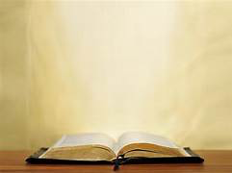
The Lesson From the Gospel
Matthew 21:22-32
²² If you believe, you will receive whatever you ask for in prayer.”
The Authority of Jesus Questioned
²³ Jesus entered the temple courts, and, while he was teaching, the chief priests and the elders of the people came to him. “By what authority are you doing these things?” they asked. “And who gave you this authority?”
²⁴ Jesus replied, “I will also ask you one question. If you answer me, I will tell you by

Slide 15
The Lesson From the Gospel
Matthew 21:22-32
what authority I am doing these things. ²⁵ John’s baptism—where did it come from? Was it from heaven, or of human origin?”
They discussed it among themselves and said, “If we say, ‘From heaven,’ he will ask, ‘Then why didn’t you believe him?’ ²⁶ But if we say, ‘Of human origin’—we are afraid of the people, for they all hold that John was a prophet.”
²⁷ So they answered Jesus, “We don’t know.”
Then he said, “Neither will I tell you by what authority I am doing these things.

Slide 16
The Lesson From the Gospel
Matthew 21:22-32
The Parable of the Two Sons
²⁸ “What do you think? There was a man who had two sons. He went to the first and said, ‘Son, go and work today in the vineyard.’
²⁹ “‘I will not,’ he answered, but later he changed his mind and went.
³⁰ “Then the father went to the other son and said the same thing. He answered, ‘I will, sir,’ but he did not go.
³¹ “Which of the two did what his father wanted?”

Slide 17
The Lesson From the Gospel
Matthew 21:22-32
“The first,” they answered.
Jesus said to them, “Truly I tell you, the tax collectors and the prostitutes are entering the kingdom of God ahead of you. ³² For John came to you to show you the way of righteousness, and you did not believe him, but the tax collectors and the prostitutes did. And even after you saw this, you did not repent and believe him.

Slide 18
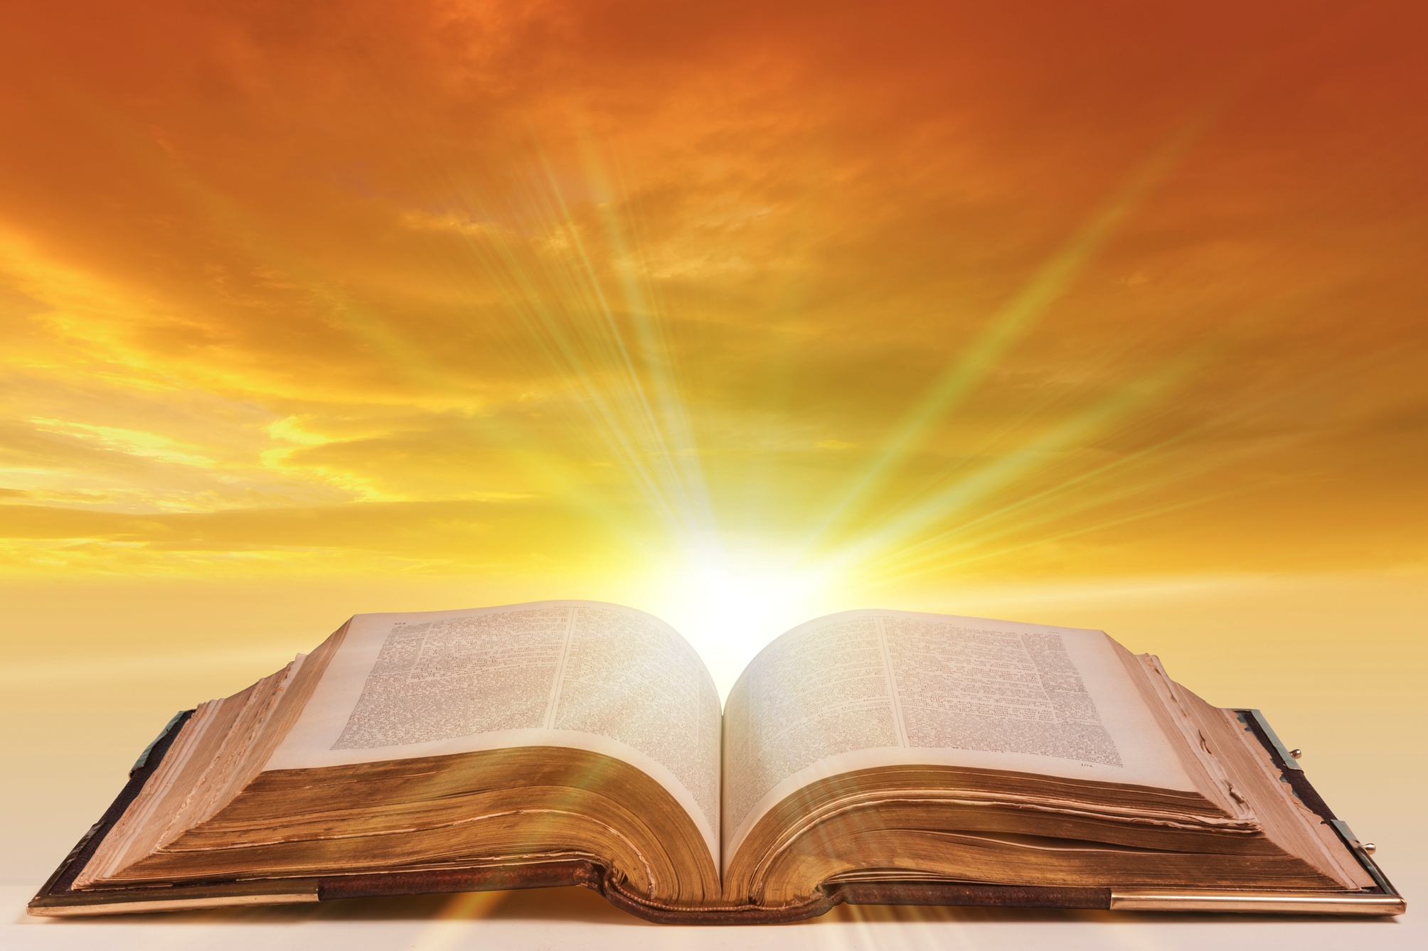
Message

Slide 19
Sacrament of Communion Leader: Though we are different—we are the same People: We are loved, judged, and forgiven by Jesus Christ Leader: Though our Father’s house has many rooms, and his dinner table includes all his children People: God knows us all by name and He has written the stories of our lives Leader: Through our brokenness and pride, we have divided ourselves People: Thanks be to the Spirit who makes us One in Christ and One with each other. Lord make us One!

Slide 20
Apostles Creed We believe in God, the Father almighty, maker of heaven and earth; And in Jesus Christ, his only Son, our Lord; who was conceived by the Holy Spirit, born of the Virgin Mary, suffered under Pontius Pilate, was crucified, dead, and buried. He descended into hell. The third day he rose again from the dead. He ascended into heaven, and sitteth on the right hand of God the Father almighty.

Slide 21
Apostles Creed From thence he shall come to judge the quick and the dead. I believe in the Holy Spirit, the holy catholic Church*, the communion of saints, the forgiveness of sins, the resurrection of the body, and the life everlasting. Amen.

Slide 22
Hymn “Let There Be Peace on Earth” (Words Projected on Wall)

Slide 23
Let there be peace on earth And let it begin with me Let There be Peace on Earth The peace that was meant to be With God as our Father Brothers all are we Let me walk with my brother In perfect harmony. Let Peace begin with me Let this be the moment now.

Slide 24
With ev’ry step I take Let this be my solemn vow To take each moment and live Each moment in peace eternally Let there be peace on earth And let it begin with me

