Slide 1
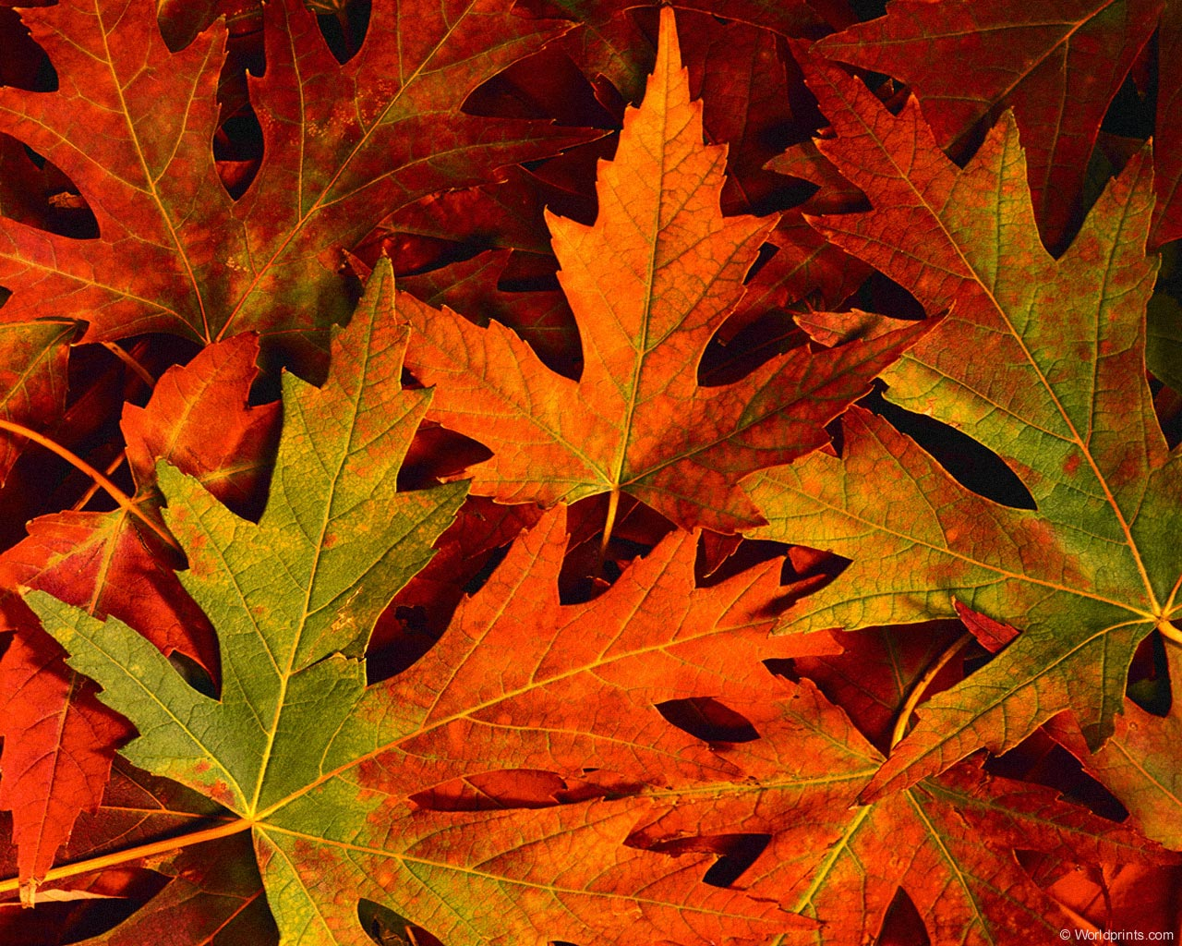
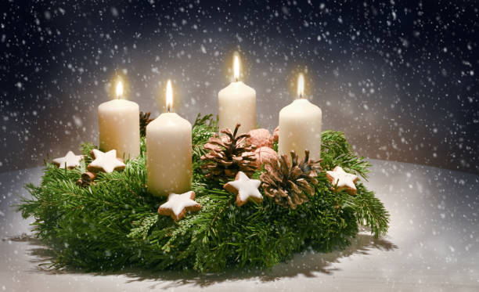
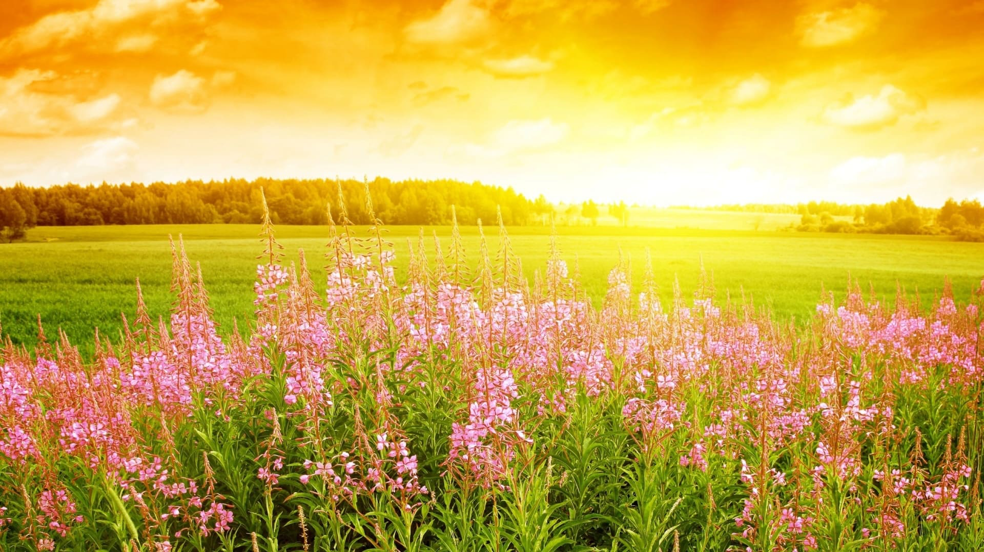
WELCOME
Welcome
WELCOME

Slide 2
The Greeting and Welcome with Announcements

Slide 3
Lighting of Advent Candle
John 3:16-18
For God so loved the world that he gave
his one and only Son, that whoever
believes in him shall not perish but have eternal life. For God did not send his
Son into the world to condemn the world,
but to save the world through him.
We light this candle in the name of Love whose birth we celebrate.

Slide 4
Pastoral Prayer

Slide 5
Hymn “Angels We Have Heard on High” #278

Slide 6
Hymn “Hark!, the Herald Angels Sing” #277

Slide 7
Unison Prayer of Confession
Lord of Christmas Peace,
we have done wrong.
We have tarnished the gift you gave freely.
We have buried you so deeply in our hearts, the world doesn't see you.
We have not followed Christ, we have ignored your teachings, we have lived lives of apathy against your love, we have built fences and fortresses

Slide 8
Unison Prayer of Confession
to push people away,
and we have silenced the screams of
those in need.
Forgive us, we pray.
Free us from our sin, Free us from our captivity, Free us to a life lived in Joy through Jesus Christ our Lord. Amen.
(Rev. Nathan Decker)
Silent Prayer

Slide 9
Unison Prayer of Response
Create in us a pure heart, O God,
and renew a steadfast spirit within
us. Do not cast us from your presence
or take your Holy Spirit from us.
Restore to us the joy of your salvation and grant us a willing spirit, to sustain us.

Slide 10
Assurance of Pardon
God gave the world the gift of
forgiveness wrapped in and through
Jesus Christ. Receive the good news-in Jesus Christ we are forgiven!

Slide 11
The Offering
Doxology
Praise God from whom all blessings flow
Praise Him, all creatures here below
Praise Him above ye heavenly host
Praise Father, Son and Holy Ghost
Amen

Slide 12
Hymn “It Came Upon the Midnight Clear” #251

Slide 13
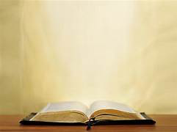
The Lesson From the Gospel
Luke 2:1-20
¹In those days Caesar Augustus issued a decree that a census should be taken of the entire Roman world.²(This was the first census that took place while Quirinius was governor of Syria.) ³And everyone went to their own town to register.
⁴So Joseph also went up from the town of Nazareth in Galilee to Judea, to Bethlehem the town of David, because he belonged to the house and line of David.

Slide 14
The Lesson From the Gospel
Luke 2:1-20
⁵He went there to register with Mary, who was pledged to be married to him and was expecting a child. ⁶While they were there, the time came for the baby to be born, ⁷and she gave birth to her firstborn, a son. She wrapped him in cloths and placed him in a manger, because there was no guest room available for them.

Slide 15
The Lesson From the Gospel
Luke 2:1-20
⁸And there were shepherds living out in the fields nearby, keeping watch over their flocks at night. ⁹An angel of the Lord appeared to them, and the glory of the Lord shone around them, and they were terrified. ¹⁰But the angel said to them, “Do not be afraid. I bring you good news that will cause great joy for all the people.¹¹Today in the town of David a Savior has been born to you; he is the

Slide 16
The Lesson From the Gospel
Luke 2:1-20
Messiah, the Lord. ¹²This will be a sign to you: You will find a baby wrapped in cloths and lying in a manger.
¹³ Suddenly a great company of the heavenly host appeared with the angel, praising God and saying,¹⁴ “Glory to God in the highest heaven, and on earth peace to those on whom his favor rests.” ¹⁵When the angels had left them and

Slide 17
The Lesson From the Gospel
Luke 2:1-20
gone into heaven, the shepherds said to one another, “Let’s go to Bethlehem and see this thing that has happened, which the Lord has told us about.”
¹⁶So they hurried off and found Mary and Joseph, and the baby, who was lying in the manger. ¹⁷When they had seen him, they spread the word concerning what had been

Slide 18
The Lesson From the Gospel
Luke 2:1-20
told them about this child, ¹⁸and all who heard it were amazed at what the shepherds said to them. ¹⁹But Mary treasured up all these things and pondered them in her heart. ²⁰The shepherds returned, glorifying and praising God for all the things they had heard and seen, which were just as they had been told.

Slide 19
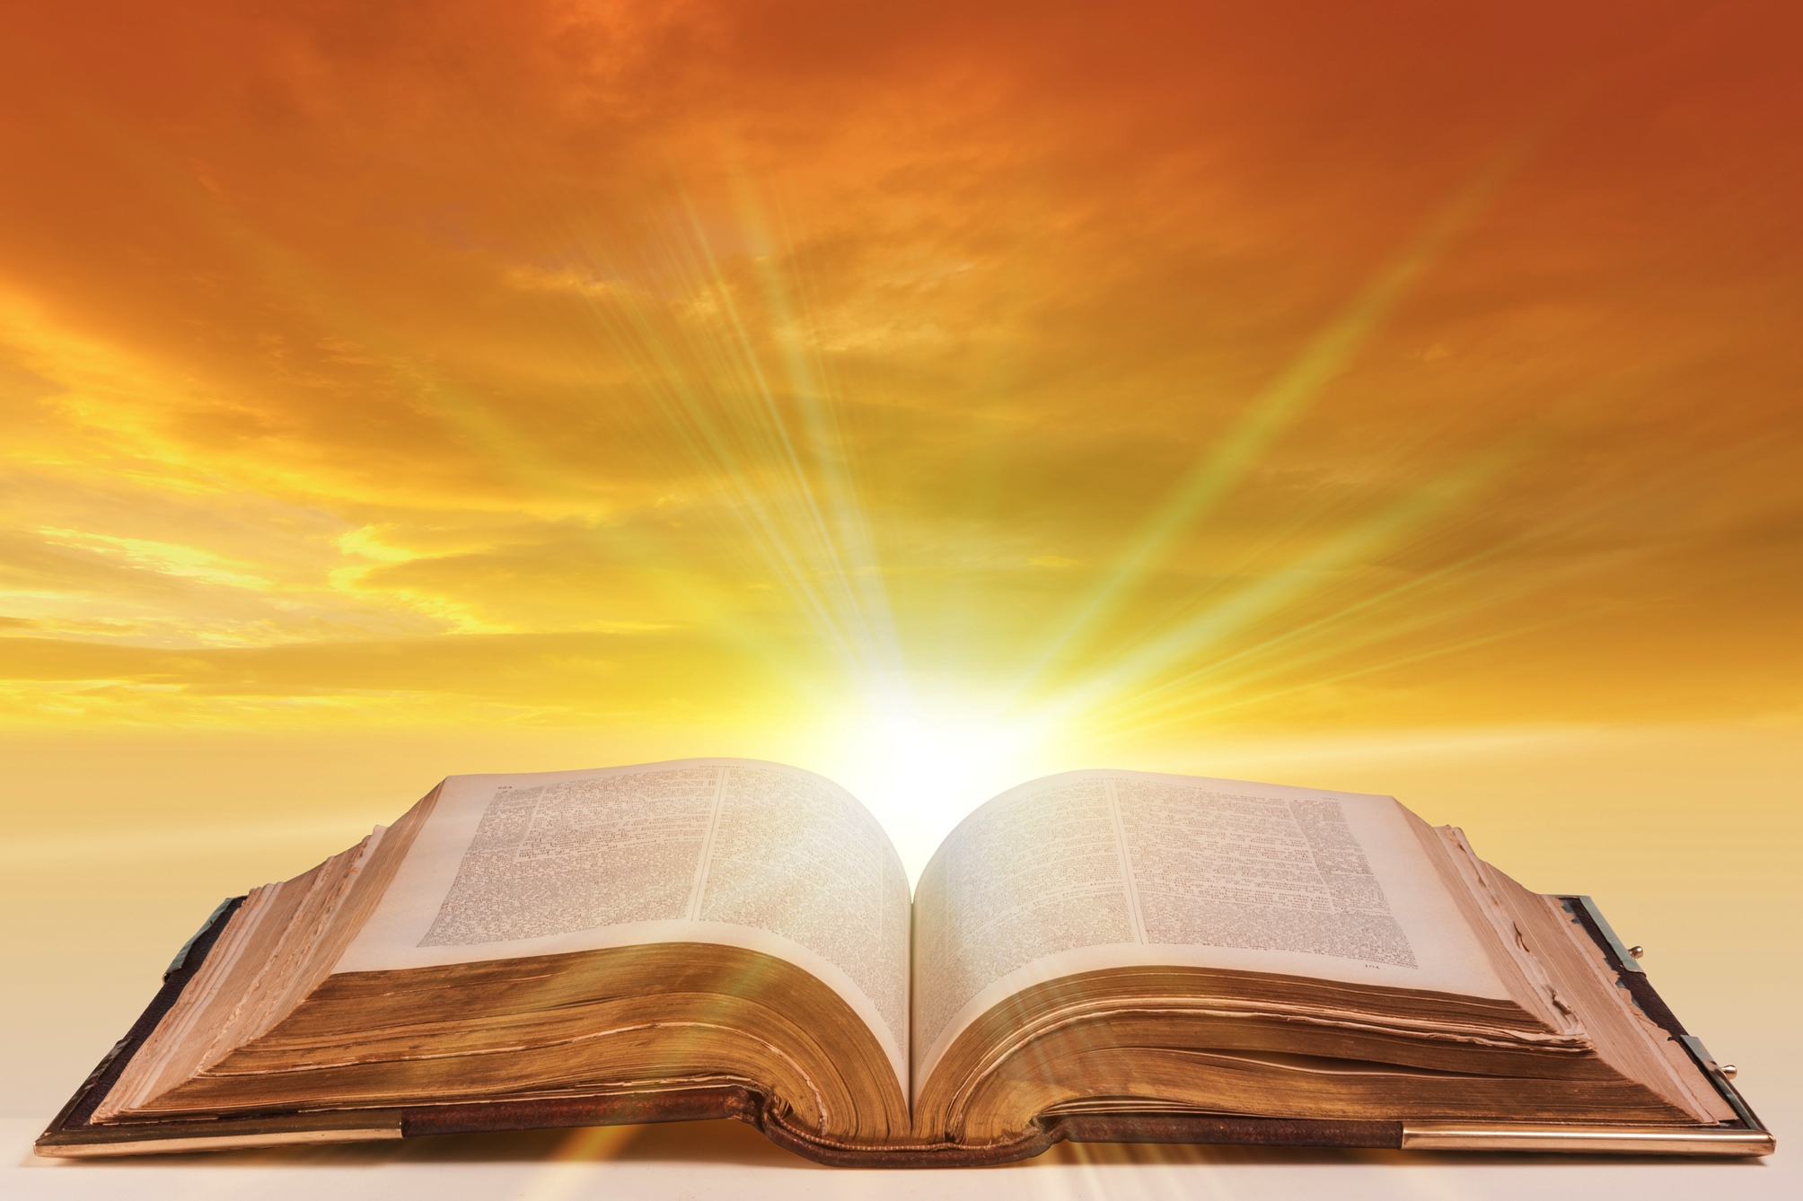
The Message

Slide 20
Hymn “Joy to the World” #270

