Slide 1
Welcome

Slide 2
The Greeting and Welcome with Announcements

Slide 3
Worship Song “Hills and Valleys” Video

Slide 4
Call to Worship
Leader: Despite how things may seem—God is good all the time People: All the time—God is good Leader: The Lord be with you People: Also with you

Slide 5
Hymn “Open My Eyes That I May See” #563

Slide 6
Unison Prayer of Confession
You came to bring light and Your light shines in the darkness!
Forgive us for choosing darkness instead of Your Light.
You came to bring love and Your love rises above hatred!
Forgive us for choosing hatred instead of Your love.

Slide 7
Unison Prayer of Confession
You came to bring life and Your life conquers death!
Forgive us for choosing death instead of Your life.
You came to call those who were against You, Your friends!
Forgive us treating your friends as our enemies.

Slide 8
Unison Prayer of Confession
You came to establish the Kingdom of God on earth as it is in heaven!
Forgive us for being more in love with the ways of the earth instead of the ways of heaven.
Time of silence

Slide 9
Unison Prayer
Soul of Christ, sanctify us; Body of Christ, save us;
Blood of Christ, inebriate us; Water from the side of Christ, wash us;
Passion of Christ, strengthen us; O good Jesus hear us.
(Anima Christi)

Slide 10
Words of Affirmation
Beloved of the Lord God, receive this Good News. As Far as the North is from South and the East is from the West, that is how far God has removed our sins from us in Jesus Christ! In the name of Jesus Christ, we are forgiven. Thanks be to God!

Slide 11
Time of Testimony and Prayer
Discipline of Gratitude: Thanking
God for what God has done.
Prayers of the People
Lord’s Prayer

Slide 12
The Offering
Doxology
Praise God from whom all blessings flow
Praise Him, all creatures here below
Praise Him above ye heavenly host
Praise Father, Son and Holy Ghost
Amen

Slide 13
Worship Song “I Lift My Hands” Video

Slide 14
The Lesson From the Gospel
Mark 9:2-9
² After six days Jesus took Peter, James and John with him and led them up a high mountain, where they were all alone. There he was transfigured before them. ³ His clothes became dazzling white, whiter than anyone in the world could bleach them. ⁴ And there appeared before them Elijah and Moses, who were talking with Jesus.

Slide 15
The Lesson From the Gospel
Mark 9:2-9
⁵ Peter said to Jesus, “Rabbi, it is good for us to be here. Let us put up three shelters—one for you, one for Moses and one for Elijah.”
⁶ (He did not know what to say, they were so frightened.)
⁷ Then a cloud appeared and covered them, and a voice came from the cloud: “This is my Son, whom I love. Listen to him!”

Slide 16
The Lesson From the Gospel
Mark 9:2-9
⁸ Suddenly, when they looked around, they no longer saw anyone with them except Jesus.
⁹ As they were coming down the mountain, Jesus gave them orders not to tell anyone what they had seen until the Son of Man had risen from the dead.

Slide 17
The Message

Slide 18
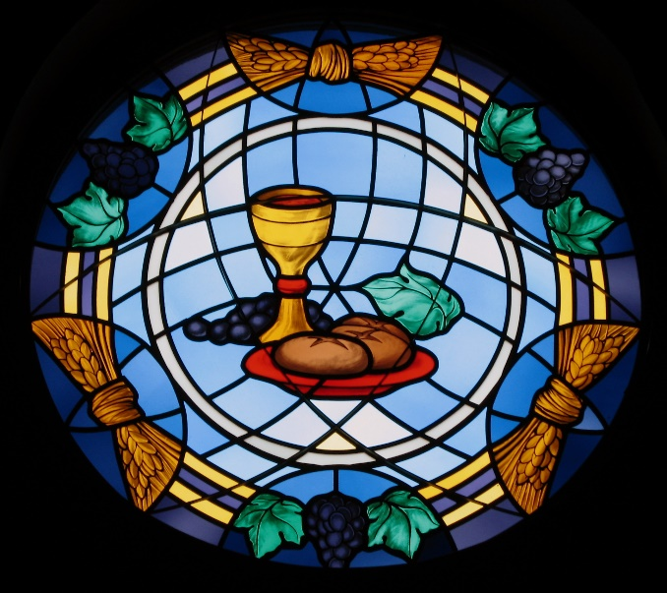
Sacrament of Communion

Slide 19
Hymn “Shine, Jesus, Shine” #431

