Slide 1
Welcome

Slide 2
Announcements
Lenten Study—Please pick up the Lenten Study on the table by the door. It is a once a week reading, prayer, and action for this time of Lent.
VBS Launch Meeting—Today at 12:30pm for anyone who is interested in helping with VBS in June. A light lunch will be served.
Easter Flower Orders—There are order forms at the Ann Street door entrance to order flowers for Easter. Today is the last day to order.
Nomination of Elders--The Nominating Committee is now accepting nominations for this year. There are nomination forms at the Ann Street entrance. Please prayerfully consider nominating members and also keep the Nominating Committee in prayer. Place competed forms in the offering plate.
Kids Club—Every Sunday through March 24 4-5:00pm. We will be looking at superheroes of the New Testament. Our friends from Bethel Presbyterian will be there helping us again.
One Great Hour of Sharing—There are brochures and donation envelopes at the entrance door. We will collect donations until Easter Sunday.

Slide 3
The Greeting and Welcome with Announcements

Slide 4
Worship Song “Holy Forever” Video

Slide 5
Call to Worship
Leader: Despite how things may seem—God is good all the time People: All the time—God is good Leader: The Lord be with you People: Also with you

Slide 6
Hymn “To God Be the Glory” #56

Slide 7
Unison Prayer of Confession
You came to bring light and Your light shines in the darkness!
Forgive us for choosing darkness instead of Your Light.
You came to bring love and Your love rises above hatred!
Forgive us for choosing hatred instead of Your love.

Slide 8
Unison Prayer of Confession
You came to bring life and Your life conquers death!
Forgive us for choosing death instead of Your life.
You came to call those who were against You, Your friends!
Forgive us treating your friends as our enemies.

Slide 9
Unison Prayer of Confession
You came to establish the Kingdom of God on earth as it is in heaven!
Forgive us for being more in love with the ways of the earth instead of Your ways O’ God.
Time of silence

Slide 10
Unison Prayer
Soul of Christ, sanctify us; Body of Christ, save us;
Blood of Christ, inebriate us; Water from the side of Christ, wash us;
Passion of Christ, strengthen us; O good Jesus hear us.
(Anima Christi)

Slide 11
Words of Affirmation
Beloved of the Lord God, receive this Good News. As Far as the North is from South and the East is from the West, that is how far God has removed our sins from us in Jesus Christ! In the name of Jesus Christ, we are forgiven. Thanks be to God!

Slide 12
Time of Testimony and Prayer
Discipline of Gratitude: Thanking
God for what God has done.
Prayers of the People
Lord’s Prayer

Slide 13
The Offering
Doxology
Praise God from whom all blessings flow
Praise Him, all creatures here below
Praise Him above ye heavenly host
Praise Father, Son and Holy Ghost
Amen

Slide 14
Worship Song “Cornerstone” Video

Slide 15
The Lesson From the Gospel
Ephesians 2:1-10
¹As for you, you were dead in your transgressions and sins, ²in which you used to live when you followed the ways of this world and of the ruler of the kingdom of the air, the spirit who is now at work in those who are disobedient. ³All of us also lived among them at one time, gratifying the cravings of our flesh and following its desires and thoughts. Like the rest, we were by nature

Slide 16
The Lesson From the Gospel
Ephesians 2:1-10
deserving of wrath. ⁴ But because of his great love for us, God, who is rich in mercy, ⁵ made us alive with Christ even when we were dead in transgressions—it is by grace you have been saved. ⁶ And God raised us up with Christ and seated us with him in the heavenly realms in Christ Jesus, ⁷ in order that in the coming ages he might show the incomparable riches of his

Slide 17
The Lesson From the Gospel
Ephesians 2:1-10
grace, expressed in his kindness to us in Christ Jesus. ⁸ For it is by grace you have been saved, through faith—and this is not from yourselves, it is the gift of God— ⁹ not by works, so that no one can boast. ¹⁰ For we are God’s handiwork, created in Christ Jesus to do good works, which God prepared in advance for us to do.

Slide 18
The Message

Slide 19
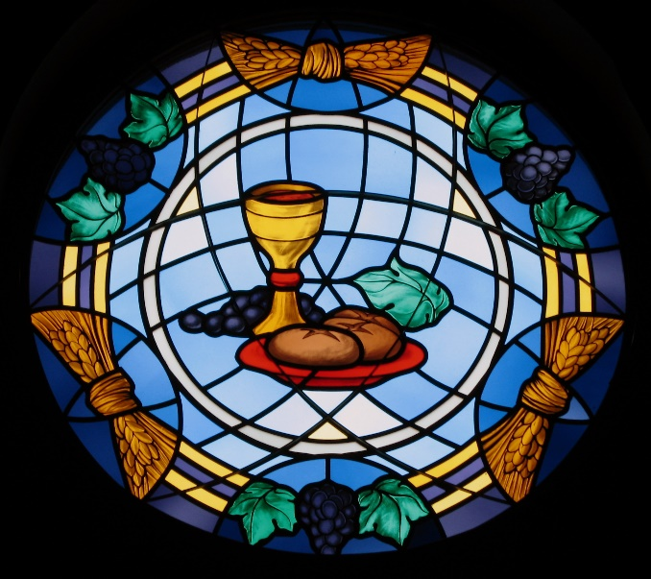
Sacrament of Communion

Slide 20
Hymn “Lift High the Cross” #450

Slide 21
Announcements
Lenten Study—Please pick up the Lenten Study on the table by the door. It is a once a week reading, prayer, and action for this time of Lent.
VBS Launch Meeting—Today at 12:30pm for anyone who is interested in helping with VBS in June. A light lunch will be served.
Easter Flower Orders—There are order forms at the Ann Street door entrance to order flowers for Easter. Today is the last day to order.
Nomination of Elders--The Nominating Committee is now accepting nominations for this year. There are nomination forms at the Ann Street entrance. Please prayerfully consider nominating members and also keep the Nominating Committee in prayer. Place competed forms in the offering plate.
Kids Club—Every Sunday through March 24 4-5:00pm. We will be looking at superheroes of the New Testament. Our friends from Bethel Presbyterian will be there helping us again.
One Great Hour of Sharing—There are brochures and donation envelopes at the entrance door. We will collect donations until Easter Sunday.

